Slide 1
Club Director: Amanda Mullen

Slide 2
Welcome to Pitt United Girls Volleyball Club Club Director -Coach Amanda Mullen
I am the Club Director/Founder of Pitt United Girls Volleyball Club. Thirteen years ago, I started the organization in hopes of providing the best experience and opportunity for girls to play club volleyball. I value teaching the techniques of the game and believe on a skill building approach for the proper and most successful development of aspiring players and experienced volleyball athletes.

Slide 3
Pitt United
Girls Volleyball Club
Meet the Coaches

Slide 4
Meet the COACHES
Pitt United Girls Volleyball Club specializes in teaching volleyball skills and techniques to all its athletes with our incredible coaching staff.
Some facts about Pitt United’s Coaching Staff:
Coaches on staff play/ed volleyball at the collegiate level. Division I, II, & III and college club teams.
Combined we bring a background of 40+ years of coaching experience into the 2024 season.
We specialize in different areas and share our knowledge about our positions with one another constantly!
Please pull out your phones at this time to save your coach's number!

Slide 5
Club Director Amanda Mullen 724-766-3180 *Please not after 8:00pm*

Slide 6
Assistant Club Director Shannon Locke 724-816-7497 *Please not after 8:00pm*

Slide 7
13s Coach Heather Richendrfer 717-676-8688

Slide 8
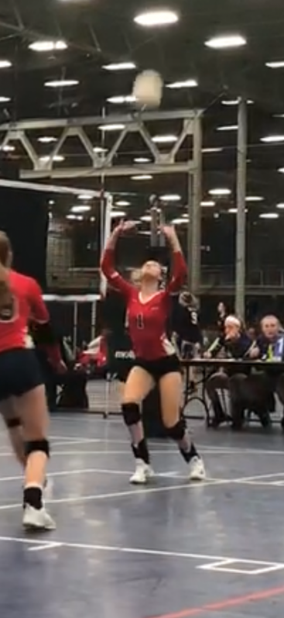
14 Red Coach Cassidy Rossi
412-291-0093

Slide 9
14 Blue Coach Hannah Geier 412-266-0476

Slide 10
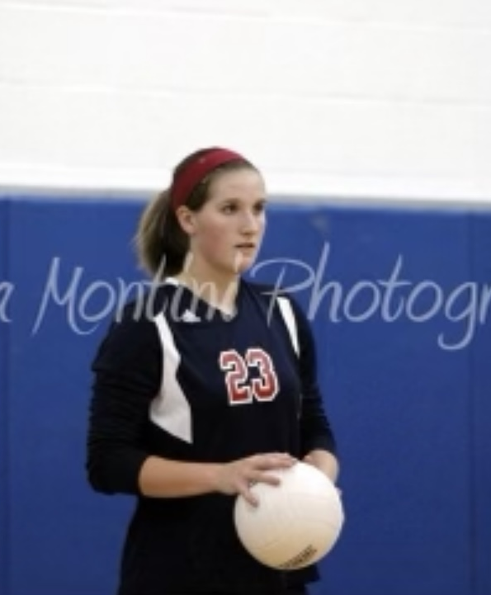
15 Red Coach Julia Bernesser 412-852-3871

Slide 11
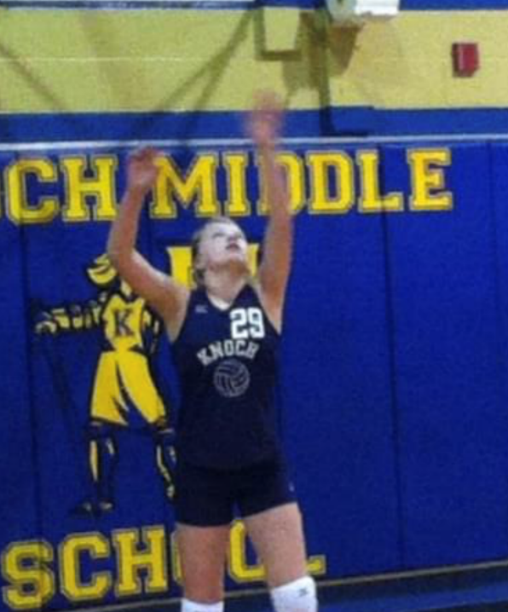
15 Blue Coach Bethany Nulph 724-996-6202

Slide 12
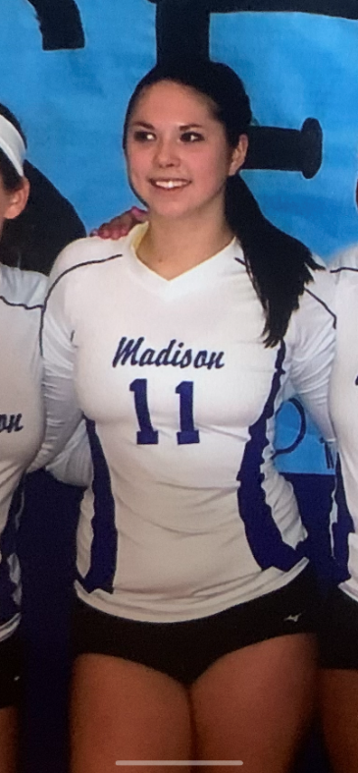
16U Coach Haley Blanc 440-344-1507

Slide 13
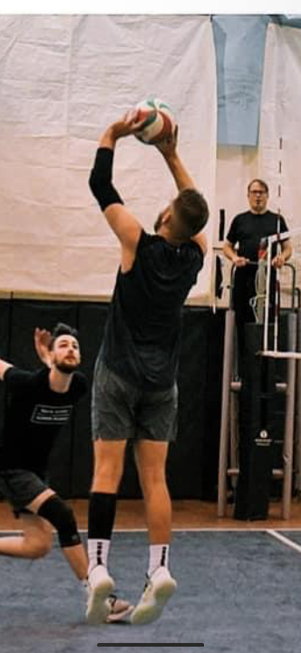
16s Coach Vance Blanc 412-804-8542

Slide 14
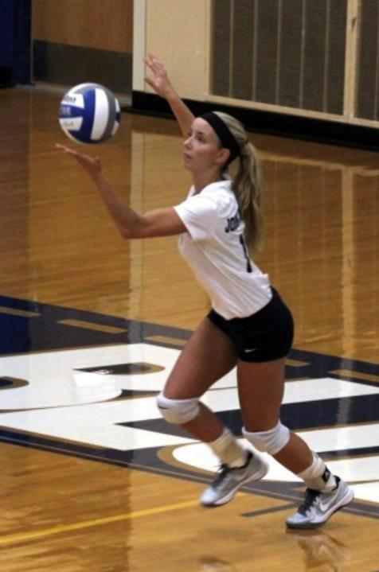
17U Coach Nicole Pilewski 412-897-2886

Slide 15
Pitt United Handbook General Club Information Handbook was emailed to members on 11/25/23

Slide 16
Handbook Main Points
- Be Responsible – Act Responsible
- Make the Commitment!
- Tournaments – we arrive together – we leave together.
- Chain of command and 24hr rule
- Fundraising
- Parental Role – be supportive!
- Payments – First Monday of the month – deposited Friday
- Correspondence (email/texts)

Slide 17
Pitt United
Girls Volleyball Club
Ball Deposits

Slide 18
Pitt United Volleyball Deposits
WHAT: Each player in the club will get a mini ball bag with ball and specific number assigned to them on their ball. This information will be in our database system. It is the responsibility of the player to shuttle this ball to and from practices and tournaments for the season. She is asked to keep track of her assigned ball to turn in at the end of the season for the deposit to be returned. Only the ASSIGNED Pitt United ball and number in its mini ball bag will be acceptable for the deposit return.
Any balls that need to be retired or excessively used/worn balls will not result in a loss of the deposit for the player/family.
WHY: To avoid the carelessness/care of our equipment. The purpose of this is to reduce the number of balls that CONSTANTLY need to be purchased EVERY YEAR!
WHEN: We would like to pass out balls and ball bags to each player on Monday, December 11th. Please bring your deposit in for this date!
Coaches can give you your ball bag and ball when you turn in your deposit.
CASH and Checks accepted. Checks should be post dated for 5/1/24.
All deposits will be returned at the end of the season party or mailed to you!

Slide 19
Pitt United
Girls Volleyball Club
Slippery Rock Tournaments
March 16th & 17th & April 27th &28th

Slide 20
Slippery Rock Tournament Requirements
All members must contribute to the concessions of the tournament. An online sign-up website will be created to organize who brings what each day.
Members who do not work their shift will be charged $100 towards their dues to the club.
WE ARE UNITED!!!

Slide 21
Pitt United
Girls Volleyball Club
Practices

Slide 22
Practices
Practices average to be 2 hours long and consist of volleyball drills and exercises, strength and conditioning and agility training.
- Individual team practices tend to be 1.5 hours
- Practices that include more than 2 teams tend to be 2.5 hours
MONDAYS- 6:30-9:00pm - Setters, Outsides and Middles St. Pauls
TUESDAYS- 5:30-7:30 -14s and 7:30-9:30 - 16s/17s St. Johns
WEDNESDAYS- 6:00-7:30 13s and 7:30-9:30 - 15s St. Johns
THURSDAYS- 6:30-9:00pm - Setters, Rightsides and Dspecs St. Pauls
SATURDAY MORNINGS- 15s-17s - Check rotating times!!! St. Johns
SUNDAY EVENINGS- 13s-14s - Check rotating times!!! St. Johns

Slide 23
February-May Practices *Starting Monday 2/5/24
 | 13s | 14R | 14B | 15R | 15B | 16s | 17s
Sunday *occasional | St. Johns 6-9pm | St. Johns 6-9pm | St. Johns 6-9pm
Monday | St. Pauls 6:30-9:00p | St. Pauls 6:30-9:00p | St. Pauls 6:30-9:00p | St. Johns 5:30-7:30p | St. Johns 5:30-7:30p | St. Johns 7:30-9:30p | St. Johns 7:30-9:30p
Tuesday | EITHER PRIVATE LESSONS – OR – PITT UNITED IN-HOUSE TRAINING
Thursday | St. Johns 6-7:30 or 7:30-9:30p | St. Johns 6-7:30 or 7:30-9:30p | St. Johns 6-7:30 or 7:30-9:30p | St. Pauls 6:30-8:30p | St. Pauls 6:30-8:30p | St. Pauls 7:30-9:30p | St. Pauls 7:30-9:30p
Saturday *alt times + positional |  |  |  | St. Johns 8-10am Post 10-11 11-1 | St. Johns 8-10am Post 10-11 11-1 | St. Johns 8-10am Post 10-11 11-1 | St. Johns 8-10am Post 10-11 11-1

Slide 24
Closed Practices
All Practices are “CLOSED” to parents/guardians.
This allows your daughter focus on instruction and the tasks at hand from their coach and coaches in the gym.
Please wait for your daughter in your car to come out with her teammates for pickup.
If there is a time coaches want to invite parents in to watch some scrimmaging amongst our teams, they will let you know prior to the practice and welcome you in at a specific time.

Slide 25
D1 - Update
Business is closing or has closed (at least the North/Cranberry location is)
Our trainer from last season (Anthony Sylvester) has happily agreed to work with us again for our Monday and Thursday trainings for December and January.
His bio is on our website and he is FANTASTIC at what he does and focusing on volleyball specific drills/conditioning to improve our players in their specific positions and in the overall game.
We excitedly welcome Anthony back for a second year with Pitt United!

Slide 26
Pitt United
Girls Volleyball Club
Tournaments

Slide 27
PITT UNITED TOURNAMENTS 2024 SEASON
13s | 14R | 14B | 15R | 15B | 16s | 17s
1/20 KRVA 13 Am. Ice Breaker Monroeville, PA | 1/21 KRVA 14 Am. Ice Breaker Monroeville, PA | 1/21 KRVA 14 Am. Ice Breaker Monroeville, PA | 1/21 KRVA 15 Am. Ice Breaker Monroeville, PA | 1/21 KRVA 15 Am. Ice Breaker Monroeville, PA | 1/20 KRVA 16 Am. Ice Breaker Monroeville, PA | 1/20 AVC Tournament GRIT Athletix Pittsburgh, PA
2/3 & 2/4 Nike Steel City Freeze Pittsburgh, PA | 2/3 & 2/4 Nike Steel City Freeze Pittsburgh, PA | 2/3 & 2/4 Nike Steel City Freeze Pittsburgh, PA | 2/3 & 2/4 Nike Steel City Freeze Pittsburgh, PA | 2/3 & 2/4 Nike Steel City Freeze Pittsburgh, PA | 2/3 & 2/4 Nike Steel City Freeze Pittsburgh, PA | 2/3 & 2/4 Nike Steel City Freeze Pittsburgh, PA
2/24 & 2/25 Tri State Slam Fest Tridelphia, WV | 2/24 & 2/25 Tri State Slam Fest Tridelphia, WV | 2/24 & 2/25 Tri State Slam Fest Tridelphia, WV | 2/17, 18 & 19 Capitol Hill Classic Washington, DC | 2/24 & 2/25 Tri State Slam Fest Tridelphia, WV | 2/17, 18 & 19 Capitol Hill Classic Washington, DC | 2/10-2/11 PA KickStarter Manheim, PA
3/1 AVC Tourn GRIT Athletix Pittsburgh, PA | 3/16 Pitt United Spring Break Slam Slippery Rock, PA | 3/9 OVR Reg Tourn Bethany, WV | 3/9 & 3/10 Lucky Charm KRVA Freedom Bid Harrisburg, PA | 3/9 & 3/10 Lucky Charm KRVA Freedom Bid Harrisburg, PA | 3/9 & 3/10 Lucky Charm KRVA Freedom Bid Harrisburg, PA | 2/17, 18 & 19 Capitol Hill Classic Washington, DC
3/10 OVR Reg Tourn Bethany, WV | 3/24 OVR Am. Tourn Leetonia HS Leetonia, Ohio | 3/16 Pitt United Spring Break Slam Slippery Rock, PA | 3/23 & 3/24 Champions Cup KRVA Bid Harrisburg, PA | 3/23 OVR Tourn Edinboro, PA | 3/17 Pitt United Spring Break Slam Slippery Rock, PA | 3/17 Pitt United Spring Break Slam Slippery Rock, PA
4/6-4/7 OVR Region Chall Sandusky, OH | 4/6-4/7 OVR Region Chall Sandusky, OH | 4/6-4/7 OVR Region Chall Sandusky, OH | 4/7 OVR Am. Challenge Dayton, OH | 4/6-4/7 OVR Region Chall Sandusky, OH | 3/23 & 3/24 Champions Cup KRVA Bid Harrisburg, PA | 3/23 & 3/24 Champions Cup KRVA Bid Harrisburg, PA
4/27 Pitt United Rally at the Rock Slippery Rock, PA | 4/13 OVR Tourn Mahon. Valley Sharpsville, PA | 4/13 West E Tourn Murrysville, PA | 4/28 Pitt United Rally at the Rock Slippery Rock, PA | 4/20 West E Tourn Murrysville, PA | 4/7 AVC Tourn GRIT Athletix Pittsburgh, PA | 4/21 West E Tourn Murrysville, PA
5/4 & 5/5 24 Can Am Classic Detroit, MI | 5/4 & 5/5 24 Can Am Classic Detroit, MI | 5/4 & 5/5 24 Can Am Classic Detroit, MI | 5/4 & 5/5 24 Can Am Classic Detroit, MI | 4/28 Pitt United Rally at the Rock Slippery Rock, PA | 5/4 & 5/5 24 Can Am Classic Detroit, MI | 5/4 & 5/5 24 Can Am Classic Detroit, MI
 |  |  |  | 5/4 & 5/5 24 Can Am Classic Detroit, MI

Slide 28
Tournament hotels
Hotel accommodations/information is done for all teams. Please book from the website!
Some tournaments require hotel accommodations and are “STAY TO PLAY” events! Please note this on the hotel page of the website!
What does that mean?!?
You MUST book in the identified hotels! NO EXCEPTIONS!!! I try my best to find nice, affordable hotels near the tournament site!
What if there isn’t a hotel listed for a tournament?
You are welcome to book your own if you want/need! ☺
What if I miss the booking deadline?
Booking outside of our stay to play requirements means your daughter may not be eligible to play in that event/be rostered. I can’t help you with eligibility.

Slide 29
Tournament hotels continued
PLEASE- Book early so you don’t miss the deadlines!
Email reminders will not always be sent.
TOURNAMENTS/HOTEL ACCOMODATIONS:
13s- Tridelphia, Sandusky, Detroit
14s (Red/Blue)- Tridelphia, Sandusky, Detroit
15R- DC, Harrisburg, Harrisburg, Detroit
15B- Tridelphia, Harrisburg, Sandusky, Detroit
16s- DC, Harrisburg, Harrisburg, Detroit
17s- Manheim, DC, Harrisburg, Detroit

Slide 30
Pitt United
Girls Volleyball Club
Tournament Philosophy

Slide 31
Tournament Philosophy
Every girl will participate in every match at every tournament.
This does not guarantee every game.
Teams are considered “Competitive Travel Teams” the expectation is to go into all matches with the mindset and goal of competing at the highest level.
Coaches will decide final lineups, subs, and rotations necessary to achieve this goal.
We are “In It To Win It!”

Slide 32
Pitt United
Girls Volleyball Club
Fundraising

Slide 33
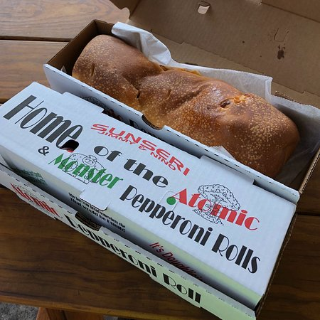
Fundraising for 2024 Season
- Popcorn Sale (ONLINE! NOW!!!)
* December → January dues
- Appleicious Fundraiser
* Jan Sale → February dues
- Hoagies and Sarris Candy Bar Sale
* February → March dues
- Pepperoni Roll Fundraiser
* March → April dues

Slide 34
Pitt United
Girls Volleyball Club
Annual Spiritwear Sale!!!

Slide 35
Spiritwear & Clothing Sale
Spiritwear Sale Starts SOON!!! - ONLY 1 SALE PER YEAR
Form will be found under the “Club Info” tab and under “Uniforms and Gear” on our website!
Collection of forms and money for spiritwear due 12/21.
Extra tryout t-shirts (red shirt with white logo) will be available to purchase this month on Monday’s at practices for anyone interested! Cost is $10 per t-shirt. Once sizes are gone – they are gone.
Cash and exact change only please!!!

Slide 36
Pitt United
Girls Volleyball Club
NEW- Picture/Media Day

Slide 37
Saturday, January 6th
ALL Teams will have designated times for pictures. No practices
Pictures available to purchase…
- Post Focus Productions
Inspiration photos and possible ideas for media day next slide.

Slide 39
Pitt United
Girls Volleyball Club
13th Annual Pitt United Picnic

Slide 40
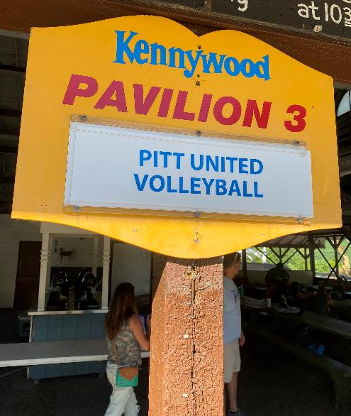
TENTATIVELY
Saturday, June 1st 2024

Slide 41
Pitt United
Girls Volleyball Club
Want to Help?!?

Slide 42
Parent Volunteers Needed!
Team Mom’s/Dad’s
Responsibilities to include:
Assisting coaches with communication to parents
Make dinner reservations or plans at overnight tournaments for the group
Organize team activities and or bonding experiences beyond practices/tournaments
Fundraising Committee/Volunteers
Responsibilities to include:
Organize and collect orders
Complete master spreadsheets for simple ordering
Separate/Organize orders per team/player when products come in for easy distribution

Slide 43
Pitt United
Girls Volleyball Club
IMPORTANT DATES/REMINDERS

Slide 44
Upcoming and Important Dates…
Monday, 12/11
* $50 Ball Deposit due
Thursday, 12/21
* Spiritwear Orders Due!!!
Friday, 12/23
* Popcorn fundraiser over at 12:00am
Saturday, 1/6
* Picture/Media Day – St. Johns all teams
Monday, 1/8
* January Dues DUE
Friday, 1/12
* Deposit made
Monday, 1/22
* Applelicious fundraiser due (2/12 DELIVERY)

Slide 45
Don’t Forget To
Watch
Watch the December calendar carefully for your practice times and locations!
Book
Book your hotels as soon as you receive this info!
Hotels won’t charge your credit card until check in!
Ask
Ask questions!
Text
Text, email... communication is key!!!

Slide 46
Pitt United
Girls Volleyball Club
Questions???

Slide 47
Pitt United
Girls Volleyball Club
Thank you for being here today!

